Slide 1
BUS 6000
Techniques for Reading Business Texts

Slide 2
Part I: Vocabulary
Exercise - 1
________ 1. assets
________ 2. board of directors
________ 3. human resource
________ 4. code of ethics
________ 5. management
________ 8. marketing
________ 6. consumerism
________ 9. franchisee
________ 7. business
________ 10. boycott
BUS 6000

Slide 3
Part I: Vocabulary
Exercise - 1
___E_____ 1. assets
___H_____ 2. board of directors
___D_____ 3. human resource
___C_____ 4. code of ethics
___J_____ 5. management
____I____ 8. marketing
___A_____ 6. consumerism
____G___ 9. franchisee
___B____ 7. business
_____F___ 10. boycott
BUS 6000

Slide 4
Part I: Vocabulary
Exercise - 2
________ 1. Process
________ 8. Learning
________ 2. Network
________ 9. Model
________ 3. Plan
________ 10. Productivity
________ 4. Monopsony
________ 11. Role
________ 5. Concept
________ 12. Task
________ 6. Groupthink
________ 13. Value
________ 7. Cognition
_________ 14. Inventory
BUS 6000

Slide 5
Part I: Vocabulary
Exercise - 2
____G____ 1. Process
____D____ 8. Learning
____K____ 2. Network
___H_____ 9. Model
____C____ 3. Plan
____B____ 10. Productivity
____L____ 4. Monopsony
___I_____ 11. Role
____F____ 5. Concept
___M_____ 12. Task
____E____ 6. Groupthink
____A____ 13. Value
____J____ 7. Cognition
____N_____ 14. Inventory
BUS 6000

Slide 6
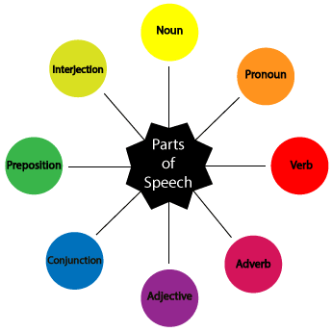
Part I: Vocabulary
Parts of Speech
BUS 6000

Slide 7
Part I: Vocabulary
Parts of Speech
1. Noun refers to words that are used to name persons, things, animals, places, ideas, or events.
a. Proper –refers to specific names of persons, places, or things.
b. Common–These are just generic names of persons, things, or places.
c. Concrete – this kind refers to nouns which you can perceive through your five senses.
d. Abstract - abstract nouns are those which you can’t perceive through your five senses.
BUS 6000

Slide 8
Part I: Vocabulary
Parts of Speech
Count – it refers to anything that is countable, and has a singular and plural form.
f. Mass – this is the opposite of count nouns. Mass nouns are also called non-countable nouns, and they need to have “counters” to quantify them.
Examples of Counters: kilo, cup, meter
Examples of Mass Nouns: rice, flour, sugar
g. Collective– refers to a group of persons, animals, or things.
Example: faculty (group of teachers), class (group of students), pride (group of lions)
BUS 6000

Slide 9
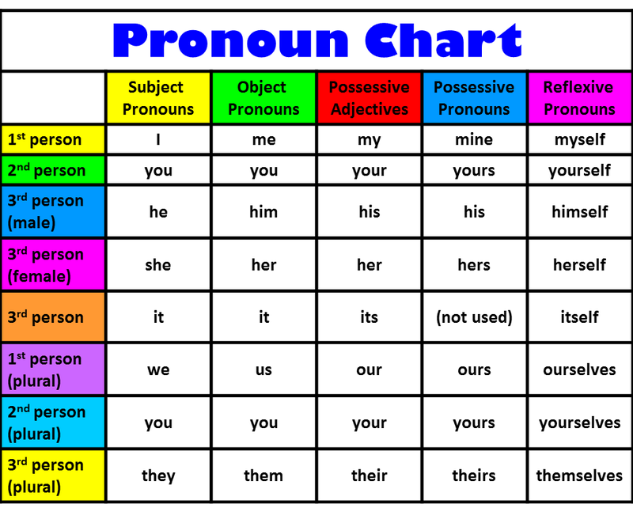
Part I: Vocabulary
Parts of Speech
2. Pronoun functions as a replacement for a noun.
BUS 6000

Slide 10
Part I: Vocabulary
Parts of Speech
3. Verb a word that shows an action (physical or mental) or state of being of the subject in a sentence.
Helping verbs (auxiliary verbs) –
be, do, have, can, could, would, may, might, must…
b. Action verbs
- Transitive verbs – eat, buy, touch, kick
- Intransitive verbs – sleep, go, stand
BUS 6000

Slide 11
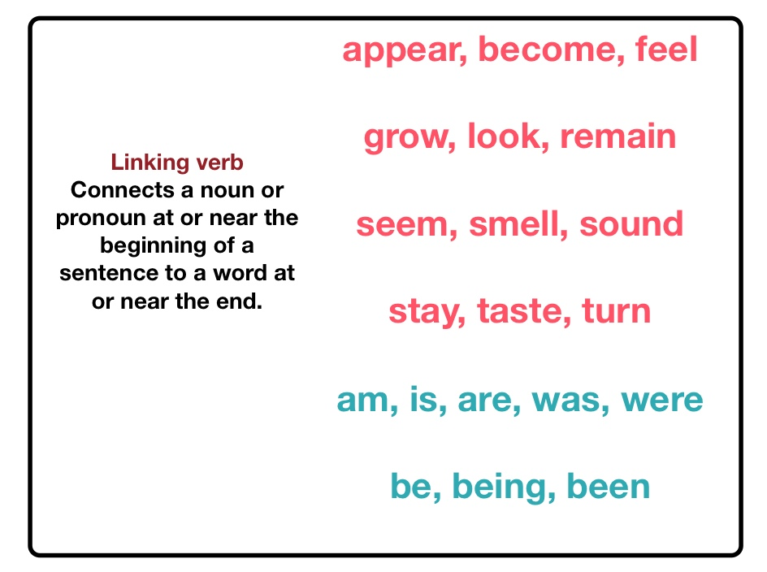
Part I: Vocabulary
Parts of Speech
c. Linking verbs – shows state of being or condition
BUS 6000

Slide 12
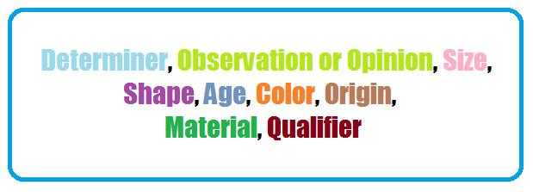
Part I: Vocabulary
Parts of Speech
Adjective - describe a noun or a pronoun.
Adjectives can specify the quality, the size, and the number
of nouns or pronouns.
the unused big long-sleeved
old blue Thai silk working shirts.
BUS 6000

Slide 13
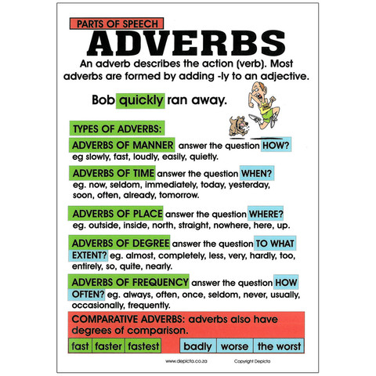
Part I: Vocabulary
Parts of Speech
5. Adverb are used to describe adjectives, verbs, or another adverb.
Manner, Time, Place, Degree, Frequency, Comparative
BUS 6000

Slide 14
Part I: Vocabulary
Parts of Speech
6. Preposition - used to form a phrase that shows the relationship between noun and the rest of sentence
Prepositions of Place
on the table, above the house, over the body, at the airport, in the box,
under the tree, towards the city
She is walking along the quiet road at night.
Prepositions of Time
at Christmas, in May, on Friday
BUS 6000

Slide 15
Part I: Vocabulary
Parts of Speech
7. Conjunction
The conjunction is a part of a speech which joins words, phrases, or clauses together
Coordinating Conjunctions link or join two words or phrases that are equally important and complete in terms of grammar when compared with each other
FANBOYS for, and, nor, but, or, yet, so
BUS 6000

Slide 16
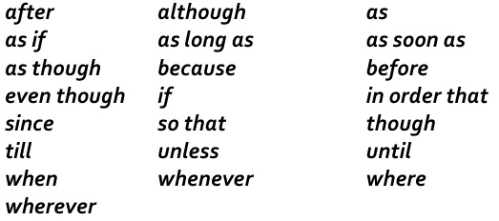
Part I: Vocabulary
Parts of Speech
Subordinating conjunctions - are used to join a subordinate dependent clause to a main clause
I went swimming although it was cold.
BUS 6000

Slide 17
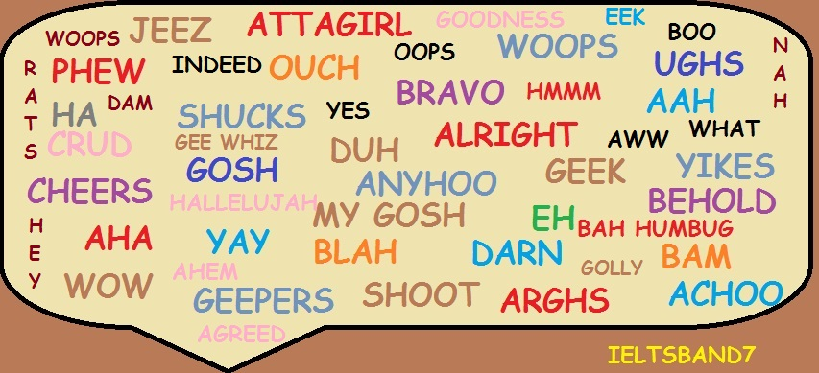
Part I: Vocabulary
Parts of Speech
8. Interjections
a word used in expressing emotions and feelings
BUS 6000

Slide 18
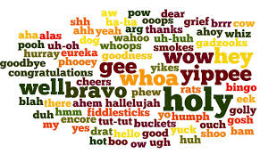
Part I: Vocabulary
Parts of Speech
8. Interjections
a word used in expressing emotions and feelings
BUS 6000

Slide 19
Part I: Vocabulary
Exercise - 5
Sentence Structure
Globalization: a worldwide marketing strategy/ in all countries to which it sells/ whereby a firm uses the same or very similar marketing programs
Globalization means a worldwide marketing strategy whereby a firm uses the same or very similar marketing programs in all countries to which it sells.
2. Patent: giving inventors the sole right/ to an invention for a period of seventeen years/ a government grant of assurance
Patent is a government grant of assurance giving inventors the sole right to an invention for a period of seventeen years
BUS 6000

Slide 20
Part I: Vocabulary
Exercise - 5
Sentence Structure
Risk: possibility of incurring a loss/ the uncertainty of / earning a profit, or
Risk is the uncertainty of earning a profit, or possibility of incurring a loss.
Markup: to the cost of a product in order to reach/ an amount added/ a selling price
Markup means an amount added to the cost of a product in order to reach a selling price.
BUS 6000

Slide 21
Part I: Vocabulary
Exercise - 5
Sentence Structure
5. Brand: them from those of competitors/ a name, term, symbol or design/ that identifies the products of one seller and differentiates
Brand is a name, term, symbol or design that identifies the products of one seller and differentiates them from those of competitors.
6. Profit: deducted from the money made in sales/ the money remaining after the expenses of producing and marketing goods or services are
Profit means the money remaining after the expenses of producing and marketing goods or services are deducted from the money made in sales deducted from the money made in sales.
BUS 6000

Slide 22
Part I: Vocabulary
Exercise -5
Sentence Structure
7. Embargo: general, or of foreign trade of specific imports or exports/ of foreign trade in/ a prohibition or suspension
Embargo is a prohibition or suspension of foreign trade in general, or of foreign trade of specific imports or exports.
8. Authority: the right to/ take the action/ necessary to accomplish an assigned task
Authority means the right to take the action necessary to accomplish an assigned task.
BUS 6000

Slide 23
Part I: Vocabulary
Exercise - 5
Sentence Structure
9. Innovation: in a new process, product, services, or other outcome/ successful development and/ application of a novel idea resulting
Innovation means successful development and application of a novel idea resulting in a new process, product, services, or other outcome.
10. Objective: general statement of a/ an organization seeks to achieve/ future result or condition
An objective is a general statement of a future result or condition an organization seeks to achieve.
BUS 6000

Slide 24
Part I: Vocabulary
Exercise - 5
Sentence Structure
11. Career: or professional pursuits that are/ a sequence of jobs/ work-related and tend to be lifelong
Career means a sequence of jobs or professional pursuits that are work-related and tend to be lifelong.
12. Price: the amount of money paid to/ of sale/ purchase a product, together with the conditions
Price means the amount of money paid to purchase a product, together with the conditions of sale.
BUS 6000

Slide 25
Part I: Vocabulary
Exercise - 1
consumerism
1.Organized-efforts by individuals, groups, and governments to help protect consumers from policies and practices that infringe consumer rights to fair business practices.
2. Doctrine that ever-increasing consumption of goods and services forms the basis of a sound economy.
3. Continual expansion of one's wants and needs for luxury goods and services.
BUS 6000

Slide 26
Part I: Vocabulary
Exercise - 6
Then there is the subtle art of discrediting opponents.
delicate, refined
2. The evaluation of an individual by his peer has proven to be effective in predicting future management success. colleague, associate
3. Creativity and innovation depend on open, informal environments where people feel free to express their views, disagree, and challenge the status quo.
present position
4. A policy is a general guideline for handling various organizational activities ranging from major investment projects to minor work schedules. managing, organizing

Slide 27
5. Performance can lead to two kinds of rewards: intrinsic and extrinsic. External
6. In 1776, Adam Smith warned that the division of labor could lead to an adverse impact on workers despite its economic advantages. contrary, opposing
7. From these diverse views, further discussion yielded few new insights. understanding, visions
8. Scientific management also inspired an early philosophy of management. stimulated, encouraged

Slide 28
9. Energy developments of the period also deserve mention. be worthy of
10. It sometimes happens, too, in the interplay of wills and forces that the few might block the many.
interact
11. Employees with higher morale clearly have better attendance records and stay on their jobs longer than do employees with low morale.
self-esteem, spirit
12. Communication is pervasive in all areas of organization life. widespread, distributed

Slide 29
13. E-business means delivering products and service directly to individual consumers through the Internet.
single, specific
14. In the growth stage, sales increase rapidly and profits peak, then start to decline. top, highest, topmost
15. It is a healthy sign for management succession to have a number of key executives in competition with each other for the top jobs. sequence, inheritance
16. Spam, or unsolicited commercial e-mail (UCE), has become a major source of discontent with the Internet. dissatisfaction, unhappiness

Slide 30
17. A director’s functions are numerous, and anyone has only to attend a routine meeting of a board to see most of these functions performed. diverse, many, various
18. There are, of course, many other factors involved in the process of decision-making.
engaged, implicated
19. Leadership is a highly complex and elusive trait.
indefinable, ambiguous
20. Organizational structure is one of the tangible aspects of the organization that affects its climate.
noticeable, perceptible, concrete

Slide 31
21. This special attention resulted in the charge that the observers biased the experiment by their personal involvement, the so-called Hawthorn effect.
caused of , brought about
22. The conflicts of interest between individuals and society frequently pose ethical problems. cause
23. Marketing requires creativity and consumer focus because environment forces can change quickly and dramatically. vividly, intensely
24. The key to developing a marketing strategy is maintaining the right marketing mix that satisfies the target market and creates long-term relationship with customers. makes, generates

Slide 32
25. If rewards are satisfactory, employees will develop positive valence on future rewards.
anticipation, expectation
26. Instead of e-business changing all industry, it has had much more impact in certain industries where the cost of business and consumer transaction is very high.
business deal
27. Most labor disputes are handled through collective bargaining or through grievance procedures. complaint
28. The extraordinary growth of information technology, the Internet, and e-business has generated many legal and social issues for consumers and businesses. exceptional, special

Slide 33
29. A feature of all groups is that informal leaders emerge. arise, occur
30. Businesses have long tracked consumers’ shopping habits with little controversy. traced, followed
31. According to Henry Mintzberg, communication plays a vital part in performing managerial, interpersonal, informational, and decision roles.
essential, crucial
32. Eastern had gained profitability in early 1985 but quickly lost it by the year’s end.
earned, obtained, received

Slide 34
33. Sometimes the status of a position can be measured simultaneously by several standards, each of which has little relationship to the others.
at the same time, concurrently
35. There is no better way for learning small business management than by becoming an apprentice or working for a successful entrepreneur. trainee, novice
36. Naturally, when two or more people pool their money and credit, it is easier to pay the rent, utilities, and other bills incurred by a business.
encountered, experienced
37. The complaints gathered in the interviews were thoroughly investigated and found generally to be irrelevant to the facts. unrelated, unconnected

Slide 35
38. In all forms of life, from interpersonal relations to the handling of international disputes, power-over had to be reduced and obedience had to be shifted to the law of the situation. removed, changed
39. A rule or regulation specifies a set of behaviors that must be carried out in a certain situation.
completed, accomplished
40. Involvement, improvement, and achievement are implicit in any scheme for management by objectives, but all this must be actively stimulated by carefully planned internal publicity geared to success.
inferable, inherent

Slide 36
41.Cost remains the greatest handicap in competing against foreign manufacturers. disadvantage, drawback, impediment
42. No manager can expect his subordinates to be productive if he does not set high standards or goals for them and enforce these standards. fruitful, prolific, efficient
43. Stock purchase plans are another compensation benefit for executives and managers. payment, returns, rewards
44. Some years ago, European companies faced with labor shortages, experimented with flexible hours. encountered, came across

Slide 37
45. Having settled in which a mainframe computer. It is still wise for management to keep up to date with subsequent development. catch up with
46. Instead of working through wholesalers, a company decides to set up its own retail outlets. establish, settle
47. Harry pointed out that this approach allowed time to determine whether an economic recession. decline. downturn
48. Another study illustrating the effect of employee performance upon leadership behavior was conducted in the upholstery department of a furniture manufacturing company. accomplishment, achievement

Slide 38
49. The evaluation of alternatives and choosing the best alternative with the most advantages, is the most critical part. choices, options
50. Such maladjusted personality certainly can be found in the United States, but to find them aboard is disastrous, since their ego-centricity places their needs first and the needs of others second. self-centered
51. For instance, production may not be fully aware of what sales is doing, and vice versa. conversely, in opposition

Slide 39
52. Sometimes collateral evidence of job satisfaction pinpoints problems of productivity as motivational. Identifies, points out
53. Management is also responsible for protecting the company’s capital and arrange effective cover for all insurable risks over a wide range of hazards. perils, dangers
54. Stock purchase plans are another compensation benefit for executives and managers

Slide 40
Exercise 7-1
Role conflict is inevitable, because the sets of expectations that relate to the roles a person has will be overlapping and contradictory. Managers should be aware of these conflicting pressures. Increasing them can result in anxiety that is often detrimental to performance (Carlisle, 1987, p. 339).
Inevitable = unavoidable, foreseeable, predictable
contradictory = contrary, opposing, contrast
be aware of = attentive , mindful
detrimental = harmful, damaging

Slide 41
Exercise 7-2
In order to facilitate decision-making, at top level, it has always been necessary for management to have the right kind of information at the right time. In the main, this has been collected by, and processed through, various functional departments such as those dealing with marketing, production, finance, and personnel. With increasing size and complexity, however, any management information system today needs to become much more total and sophisticated (Coventry, and Barker, 1981, p. 99).
facilitate = assist, help, ease
dealing with = engaging with, contacting with
sophisticated = refined, complicated, complex

Slide 42
Exercise 7-3
The behaviorist school (often called radical behaviorists) is neutral on the issue of the nature of human beings. The advocates of B.F. Skinner’s approach believe that behavior is a function of the relationship between the individual and the environment. Because environmental conditions dominate, issues of nature-nurture and reason-emotion are moot. Changing behavior involves changing the environment, and since the environment is controllable and observable, all other considerations are insignificant (Carlisle, 1987, p. 269).
advocates = supporters, believers
approach (n) = method, procedure
approach (v) = come near
dominate = control, rule, lead
nurture = foster, raise
moot = debatable, arguable

Slide 43
Exercise 7-4
Humanistic School
This school holds human beings as growth-oriented, rational, and capable of complex problem-solving. It is an uplifting view that emphasizes providing outlets for creativity. If people are free, they will seek to improve themselves and contribute to a better society. Some of the major figures in this school are Abraham Maslow, Carl Rogers, and Douglas McGregor (Carlisle, 1987, p. 269).
holds = believes, trusts
oriented = focused, concentrated
rational = logical, reasonable
capable of = skilled, competent
uplifting = inspiring, elevating
outlets = channels, passages
figures = famous persons
contribute to = donate to, conduce to, responsible for

Slide 44
Exercise 7-5
The Halo Effect Problem
There is a “halo effect” in the appraisal when the appraiser assigns the same rating to all traits regardless of an employee’s actual performance on these traits. The problem often occurs with employees who are especially friendly (or unfriendly) toward the supervisor. For example, the “unfriendly” employee will often be rated as unsatisfactory for all traits rather than simply for the trait “gets along well with others.” A five-or ten-minute training program, showing supervisors what to avoid, can help alleviate this problem (Dessler, 1977, p. 222).
appraisal = assessment, evaluation, judgment
traits = characters, qualifications
alleviate = lessen, ease, improve

